Slide 1
DNA-REPLICATION IN PROKARYOTES
Study Material for
B.Sc. Part II
Botany Hons.
Paper IV
Dr. Pushpanjali Khare
Sr. Asstt. Professor &
Head, Deptt. of Botany
MMC (PU)
Patna

Slide 2
INTRODUCTION
Replication is an “Autocatalytic function” of DNA
This has been studied in detail by Messelson and Stahl
The mode of replication in DNA is SEMICONSERVATIVE
There are various factors involved in the replication of DNA, among which ENZYMES play a major role
DNA replication takes place in Prokaryotes as well as Eukaryotes
Different models of DNA replication has been given to understand the process of Replication in Prokaryotes and Eukaryotes separately
The replication takes place in several steps: Initiation, Elongation and Termination
In Prokaryotes replication of DNA is bidirectional

Slide 3
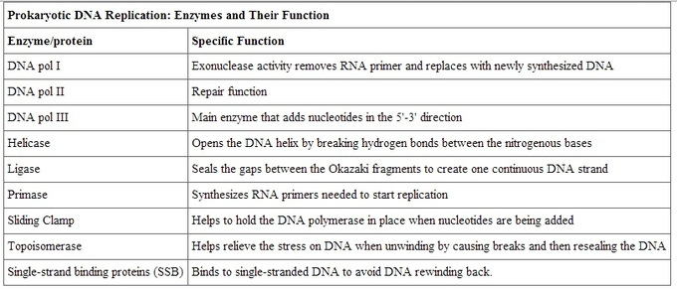
ENZYMES AND THEIR FUNCTION: USED IN DNA REPLICATION

Slide 4
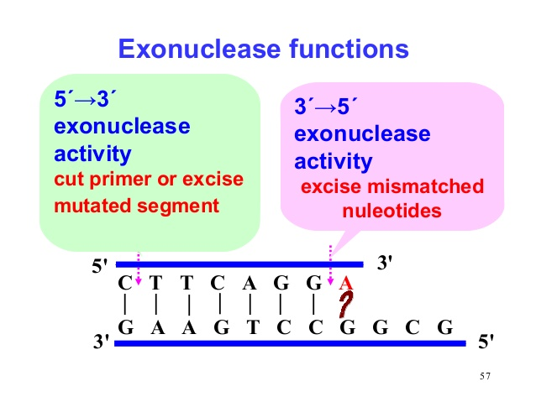
FUNCTION OF DNA pol I: EXONUCLEASE ACTIVITY
Break down of polynucleotide sequence

Slide 5
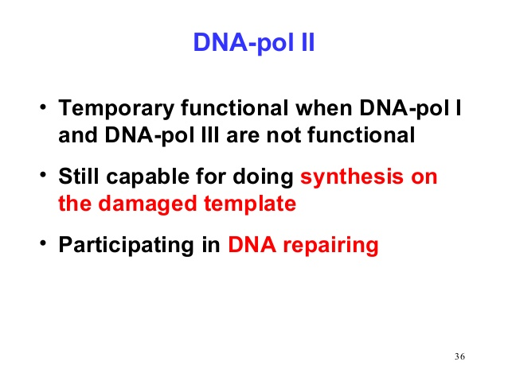
FUNCTION OF DNA pol II: REPAIR ACTIVITY

Slide 6
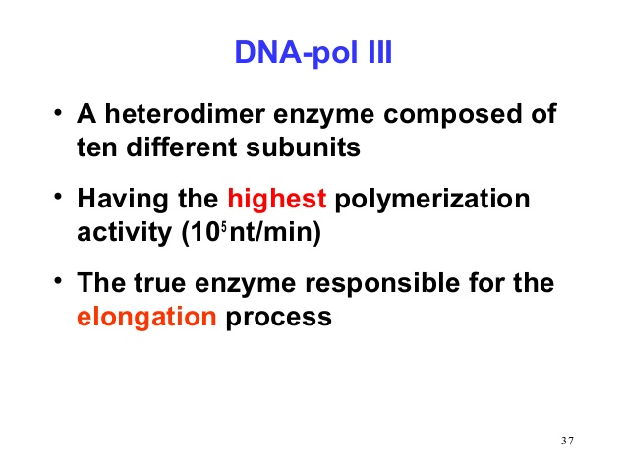
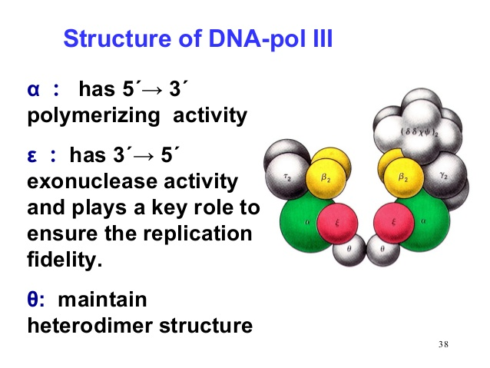
DNA pol III
STRUCTURE OF DNA pol III

Slide 7
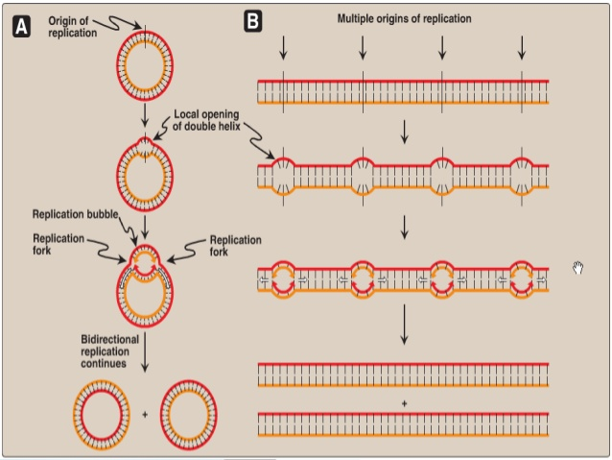
DNA REPLICATION IN PROKARYOTES

Slide 8
STEPS OF DNA-REPLICATION
INITIATION
RCCOGNITION OF ORIGIN (Ori-site)
OPENING OF DNA TO GENERATE REGION OF ssDNA
ELONGATION
FORMATION OF REPLICATION FORK
TERMINATION
TAKES PLACE AT TERMINUS REGION (Ter-site)
CAPTURE OF HELICASE ENZYME (5’---> 3’)
CONVERSION OF OKAZAKI FRAGMENTS INTO CONTINUOUS STRAND
FORMATION OF MULTIPLE PRIMERS ON LEADING AND LAGGING STRANDS
PRESENCE AND USE OF SEVERAL ENZYMES
DNA POLYMERASE ASSEMBLY REMAINS PROCESSIVE
ELONGATION STOPS
TWO REPLICATION FORK MEETS AT ONE POINT
BINDING OF TERMINATING PROTEIN(enzyme)

Slide 9
INITIATION
DNA replication begins from origin. In E coli, replication origin is called Ori C which consists of 245 base pair and contains DNA sequences that are highly conserved among bacterial replication origin. Two types of conserved sequences are found at Ori C, three repeats of 13 bp (GATRCTNTTNTTTT) and four/five repeats of 9 bp (TTATCCACA) called 13 mer and 9 mer respectively.

Slide 10
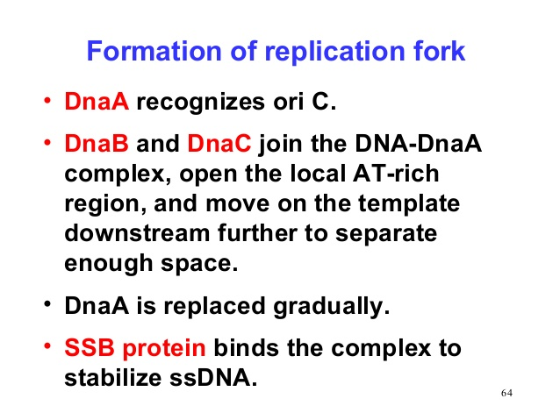
PRE-PRIMING COMPLEX
Dna A is replication initiation protein /factor in prokaryotes
Dna C loading factor for helicase B

Slide 11
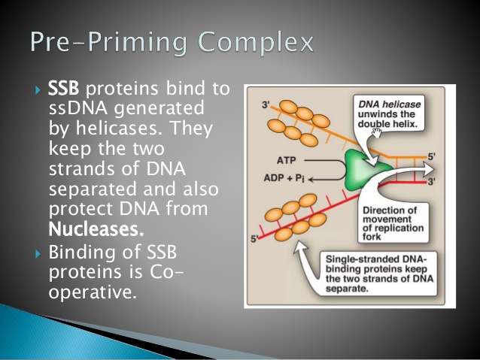
FORMATION OF REPLICATION FORK

Slide 12
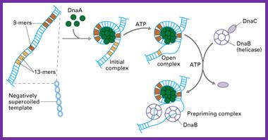
MECHANISM OF INITIATION

Slide 13
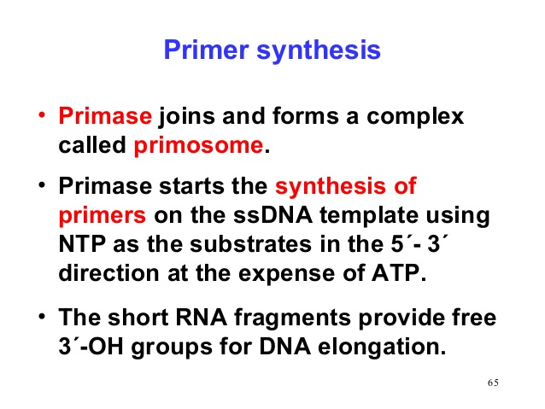
ELONGATION

Slide 14
The complexicity lies in the co-ordination of leading and lagging strand synthesis. Both the strand are synthesized by a single DNA polymerase III dimer which accomplished the looping of template DNA of lagging strand synthesizing Okazaki fragments.
Helicase (DNA B) and primase (DNA C) constitute a functional unit within replication complex called primosome complex
DNA pol III use one set of core sub unit (Core polymerase) to synthesize leading strand and other set of core sub unit to synthesize lagging strand.
In elongation steps, helicase in front of primase and pol III, unwind the DNA at the replication fork and travel along lagging strand template along 5’-3’ direction so that replication can continue
Lagging strand synthesis is not complete until the RNA primer has been removed and the gap between adjacent Okazaki fragments are sealed
The RNA primer are removed by exonuclease activity (5’-3’) of DNA pol-I and replaced by DNA
The gap is then sealed by DNA ligase using NAD as co-factor

Slide 15
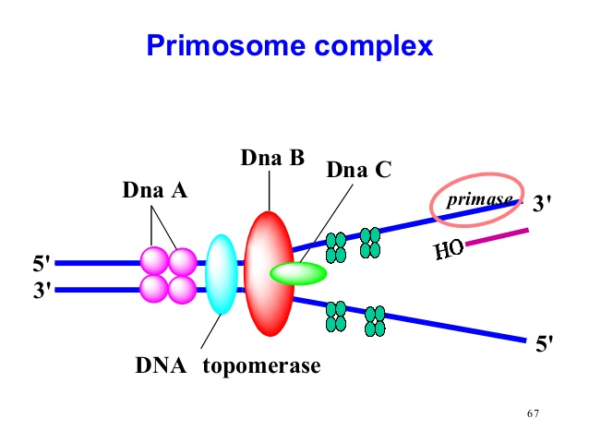
PRIMOSOME COMPLEX

Slide 16
Both leading and lagging strand are synthesized co-ordinately and simultaneously by a complex protein moving in 5’-3’ direction. In this way both leading and lagging strand can be replicated at same time by a complex protein that move in same direction.
Every so often the lagging strands must dissociate from the replicosome and reposition itself

Slide 17
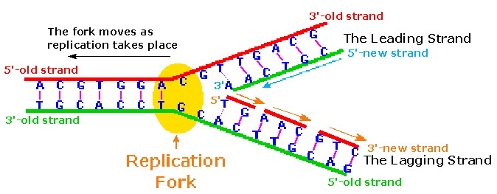
ELONGATION

Slide 18
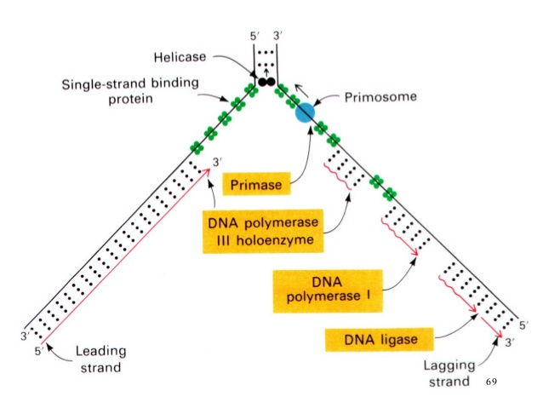

Slide 19
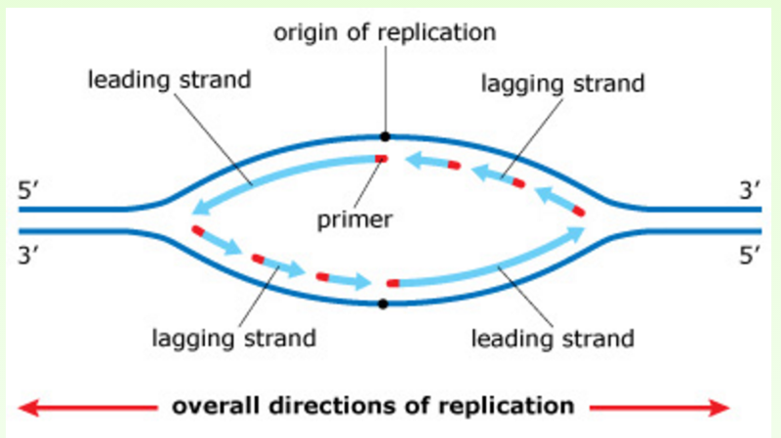
OVERALL DIRECTION OF REPLICATION

Slide 20
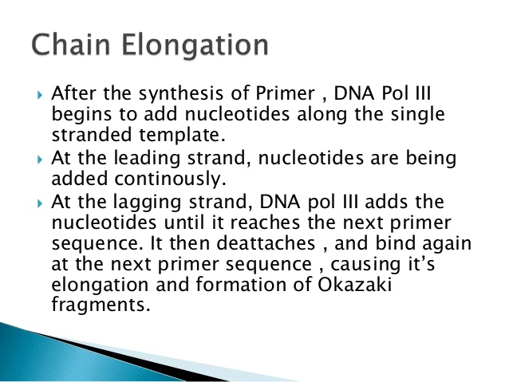
CHAIN ELONGATION

Slide 21
MECHANISM OF SYNTHESIS
i. Leading strand synthesis:
Leading strand synthesis is more a straight forward process which begins with the synthesis of RNA primer by primase at replication origin.
DNA polymerase III then adds the nucleotides at 3’end. The leading strand synthesis then proceed continuously keeping pace with unwinding of replication fork until it encounter the termination sequences (ter)
ii. Lagging strand synthesis:
The lagging strand synthesized in short fragments called Okazaki fragments. At first RNA primer is synthesized by primase and as in leading strand DNA polymerase III binds to RNA primer and adds Dntps.

Slide 22
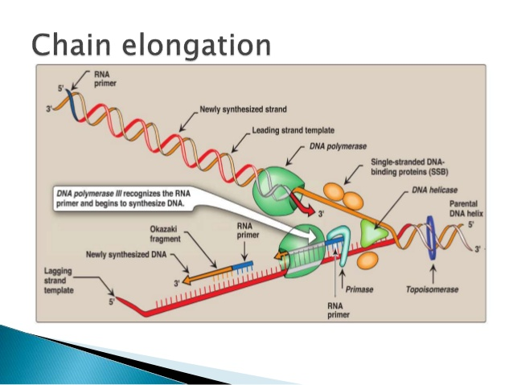

Slide 23
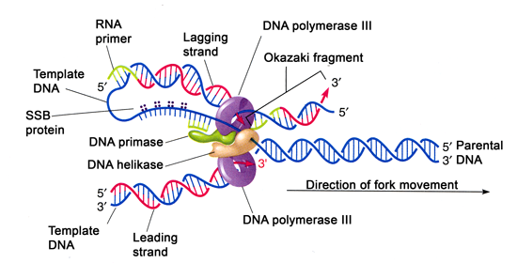
Mechanism of Lagging strand synthesis

Slide 24
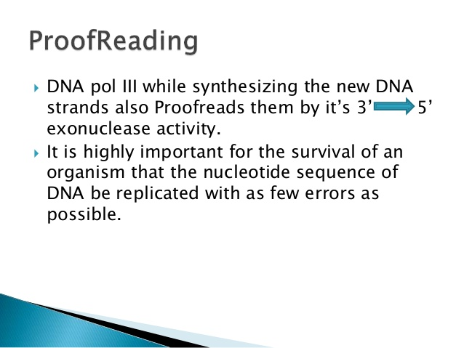
PROOF READING

Slide 25
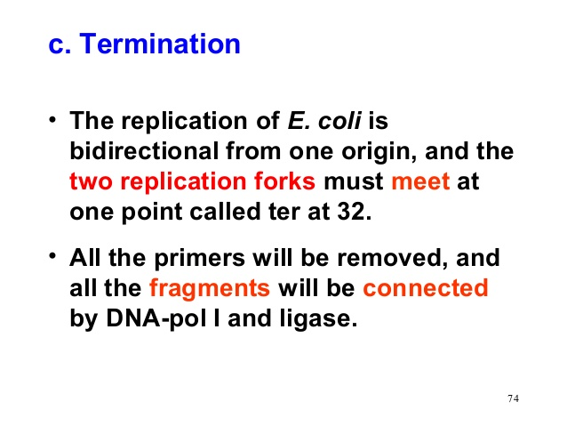
TERMINATION

Slide 26
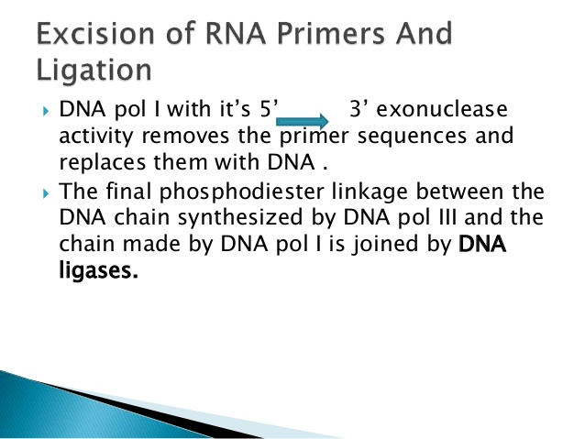
EXCISION OF RNA-PRIMERS AND LIGATION

Slide 27
TERMINATION
Eventually the two replication fork of circular E. coli chromosome meet at termination recognizing sequences (ter)
The Ter sequence of 23 bp are arranged on the chromosome to create trap that the replication fork can enter but cannot leave. Ter-sequences function as binding site for TUS protein
Ter-TUS complex can arrest the replication fork from only one direction. Ter-TUS complex encounter first with either of the replication fork and halt it. The other opposing replication fork halted when it collide with the first one. This seems the Ter-TUS sequences is not essential for termination but it may prevents over replication by one fork if other is delayed or halted by a damage or some obstacle
When either of the fork encounter Ter-TUS complex, replication halted
Final few hundred bases of DNA between these large protein complexes are replicated by not yet known mechanism forming two interlinked (cataneted) chromosome
In E. coli DNA topoisomerase IV (type II) cut the two strand of one circular DNA and segrate each of the circular DNA and finally join the strand. The DNA finally transfer to two daughter cell

Slide 28
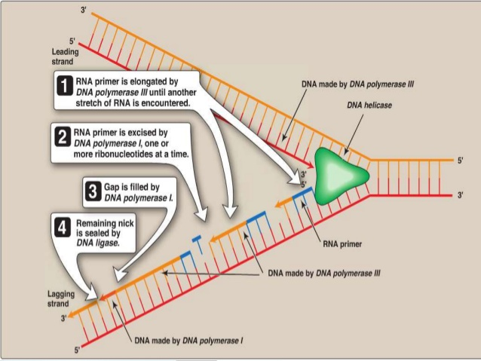

Slide 29
ROLLING-CIRCLE MODE OF REPLICATION IN PROKARYOTES
Bacterial plasmids (Unique Characteristics of Prokaryotic Cells) replicate by a process similar to that used to copy the bacterial chromosome, other plasmids, several bacteriophages, and some viruses of eukaryotes use rolling circle mode of replication
The circular nature of plasmids and the circularization of some viral genomes on infection make this possible
Rolling circle replication begins with the enzymatic nicking of one strand of the double-stranded circular molecule at the double-stranded origin (dso) site
In bacteria, DNA polymerase III binds to the 3′-OH group of the nicked strand and begins to replicate unidirectionaly, using the un-nicked strand as a template, displacing the nicked strand as it does so
Completion of DNA replication at the site of the original nick results in full displacement of the nicked strand, which may then recircularize into a single-stranded DNA molecule
RNA primase then synthesizes a primer to initiate DNA replication at the single-stranded origin (sso) site of the single-stranded DNA (ssDNA) molecule, resulting in a double-stranded DNA (dsDNA) molecule identical to the other circular DNA molecule

Slide 30
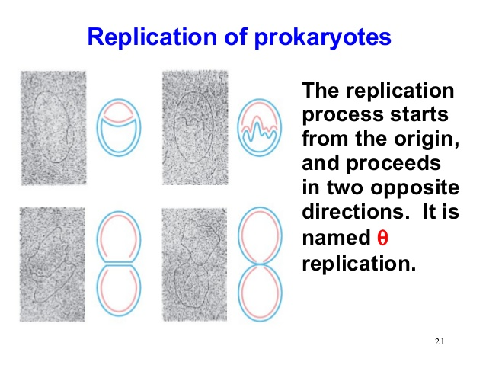
REPLICATION IN PROKARYOTES: θ REPLICATION

Slide 31
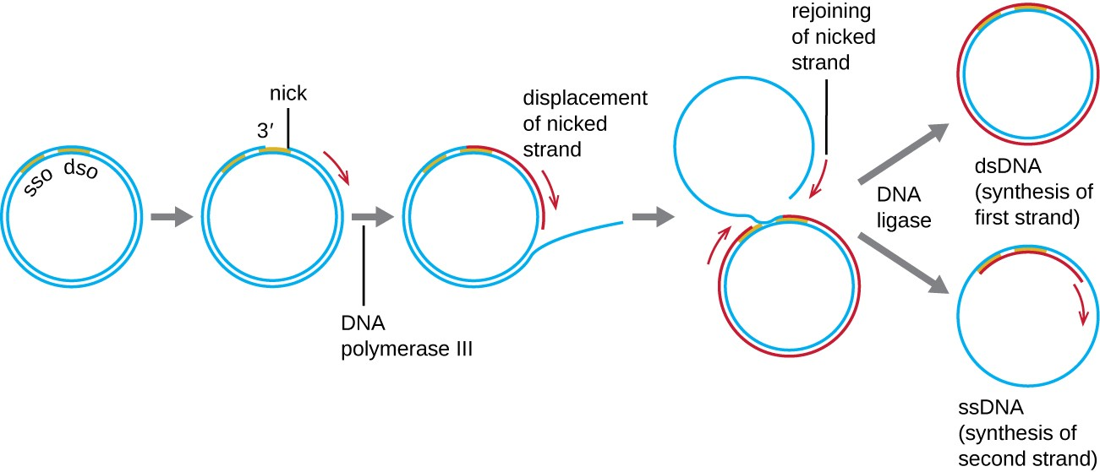
Diagram: Showing Rolling circle mode of DNA replication in Prokaryotes

Slide 32
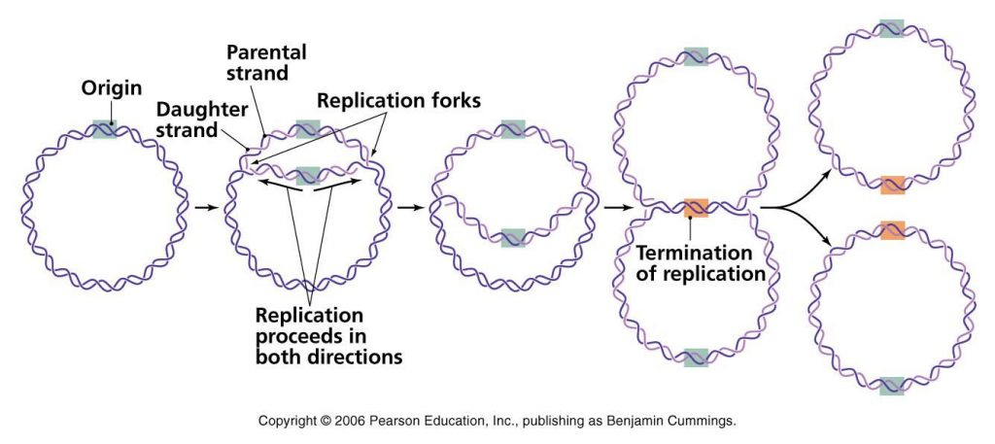
Ref: Pearson’s /Benjamin, Cummings

Slide 33
DNA- REPLICATION IN PROKARYOTES
Students are requested to share their queries on Whatsapp group: MMC Botany (D2)
OR
khare.pushpanjali2@gmail.com
OR
# 9708063491

